Slide 1

Computer Graphics
Week 5 : Midpoint (Circle)

Slide 2
circle
A circle is a collection of points that have a distance from the same center point for all points.
In general, circles are used as components of an image.
The procedure for displaying circles and ellipses is made with the basic equation of the circle 𝑥² + 𝑦 ² =𝑟 ² .
Circles can be made by drawing a quarter circle, because other parts can be made as symmetrical parts.

Slide 3
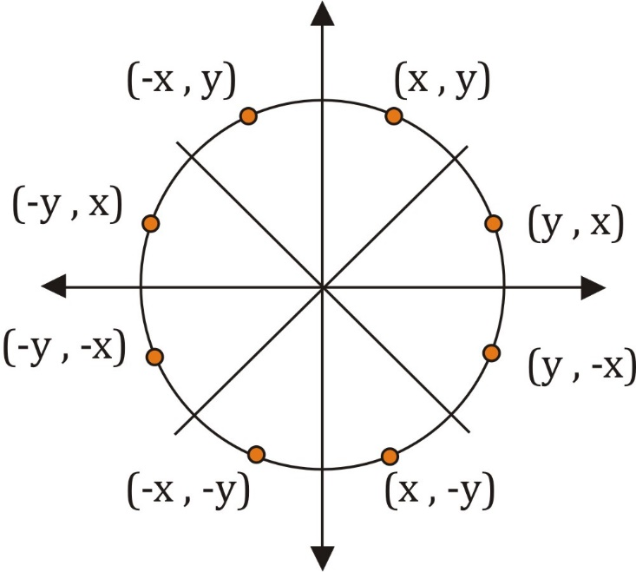
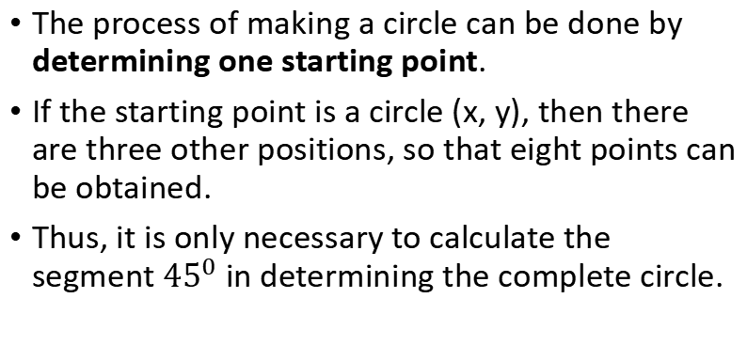
Symmetrical Eight Points
The process of making a circle can be done by determining one starting point.
If the starting point is a circle (x, y), then there are three other positions, so that eight points can be obtained.
Thus, it is only necessary to calculate the segment ${45}^{0}$ in determining the complete circle.

Slide 4
Midpoint Circle Algorithm
Midpoint Circle Algorithm uses an alternative approach, wherein the pixel positions along the circle are determined on the basis of incremental calculations of a decision parameter.

Slide 5
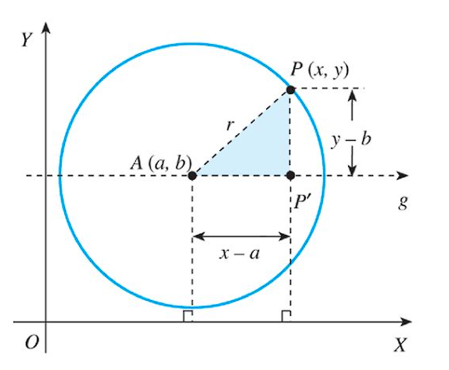

Equation of a circle with center A(a, b) and radius r
$AP=\sqrt{{\left(AP′\right)}^{2}+{\left(PP′\right)}^{2}}$
$r=\sqrt{{\left(x−a\right)}^{2}+{\left(y−b\right)}^{2}}$
$r^{2}={\left(x−a\right)}^{2}+{\left(y−b\right)}^{2}$
Notes:
Persamaan Lingkaran dengan pusat A(a, b) dan jari-jari r adalah (x-a)

Slide 6
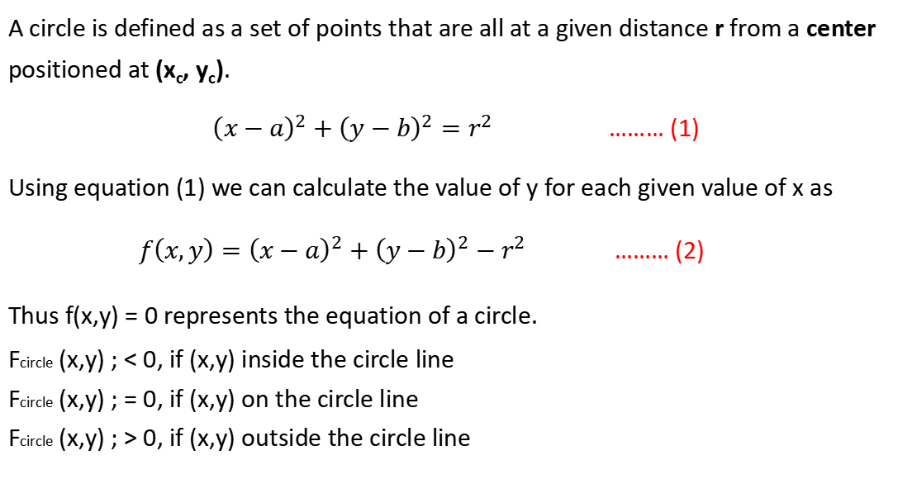
A circle is defined as a set of points that are all at a given distance r from a center positioned at (x_{c}, y_{c}).
${\left(x−a\right)}^{2}+{\left(y−b\right)}^{2}=r^{2}$ ……… (1)
Using equation (1) we can calculate the value of y for each given value of x as
${f\left(x,y\right)=\left(x−a\right)}^{2}+{\left(y−b\right)}^{2}−r^{2}$ ……… (2)
Thus f(x,y) = 0 represents the equation of a circle.
Fcircle (x,y) ; < 0, if (x,y) inside the circle line
Fcircle (x,y) ; = 0, if (x,y) on the circle line
Fcircle (x,y) ; > 0, if (x,y) outside the circle line

Slide 7
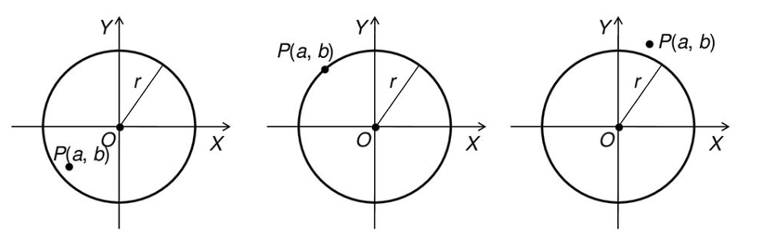
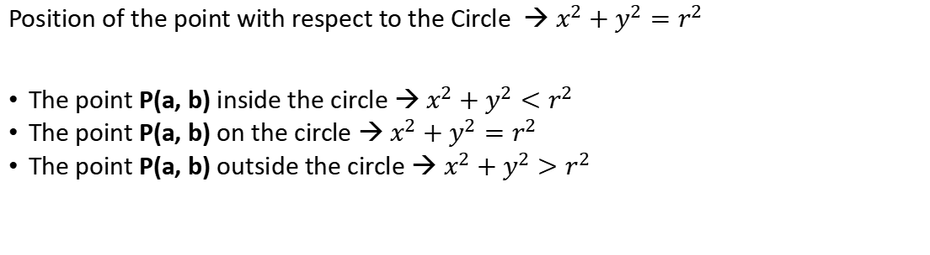
P(a, b) inside the circle line
P(a, b) on the circle line
P(a, b) outside the circle line
Position of the point with respect to the Circle → $x^{2}+y^{2}=r^{2}$
The point P(a, b) inside the circle → $x^{2}+y^{2}<r^{2}$
The point P(a, b) on the circle → $x^{2}+y^{2}=r^{2}$
The point P(a, b) outside the circle → $x^{2}+y^{2}>r^{2}$

Slide 8
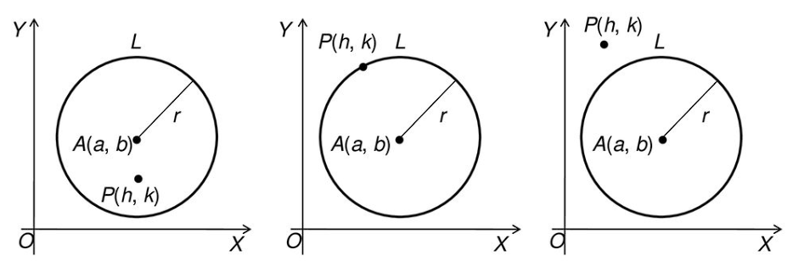
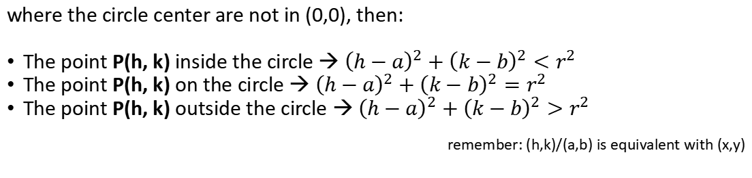
P(h, k) inside the circle line
P(h, k) on the circle line
P(h, k) outside the circle line
where the circle center are not in (0,0), then:
The point P(h, k) inside the circle → ${\left(h−a\right)}^{2}+{\left(k−b\right)}^{2}<r^{2}$
The point P(h, k) on the circle → ${\left(h−a\right)}^{2}+{\left(k−b\right)}^{2}=r^{2}$
The point P(h, k) outside the circle → ${\left(h−a\right)}^{2}+{\left(k−b\right)}^{2}>r^{2}$
remember: (h,k)/(a,b) is equivalent with (x,y)

Slide 9
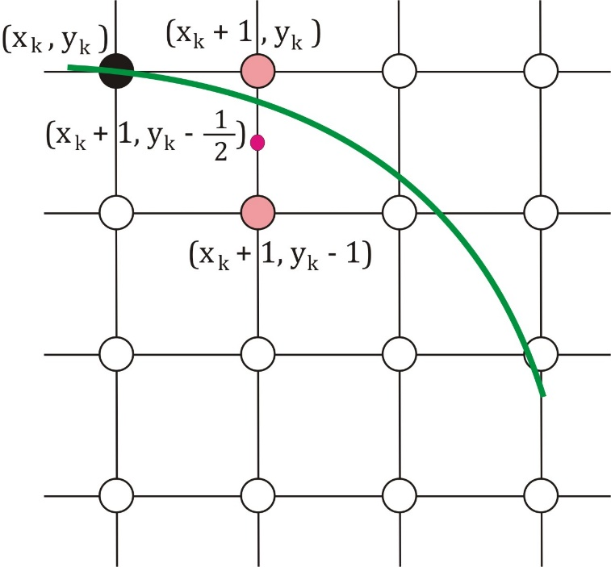
Midpoint Circle Algorithm
In Midpoint Circle Algorithm, the decision parameter at the k^{th} step is the circle function evaluated using the coordinates of the midpoint of the two pixel centres which are the next possible pixel position to be plotted.
Let us assume that we are giving unit increments to x in the plotting process and determining the y position using this algorithm.
Assuming we have just plotted the k^{th} pixel at (x_{k}, y_{k}), we next need to determine whether the pixel at the position (x_{k}, y_{k}) or the one at (x_{k} + 1, Y_{k} - 1) is closer to the circle.

Slide 10
Our decision parameter p_{k} at the k^{th} step is the circle function evaluated at the midpoint of these two pixels.
The coordinates of the midpoint of these two pixels are (x_{k} + 1, y_{k} - 1/2).
Thus p_{k}:
p_{k} = f(x_{k} + 1, y_{k} - 1/2)
= (x_{k} + 1)² + (y_{k} - 1/2)² - r² ……… (3)

Slide 11
We obtain a recursive expression for the next decision parameter i.e. at the k + 1th step, in the following manner.
Using Equ. (4), at the k + 1th step, we have:
p_{k+1} = f(x_{k+1} + 1, y_{k+1} - 1/2)
= (x_{k+1} + 1)² + (y_{k+1} - 1/2)² - r²
= (x_{k} + 1 + 1)² + (y_{k+1} - 1/2)² - r²
= (x_{k} + 2)² + (y_{k+1} - 1/2)² - r² ……… (4)
Equ. (4) – (3)
p_{k+1} - p_{k} = (x_{k} + 2)² + (y_{k+1} - 1/2)² - r² - ((x_{k} + 1)² + (y_{k} - 1/2)² - r²)
= (x_{k} + 2)² - (x_{k} + 1)² + (y_{k+1} - 1/2)² - (y_{k} - 1/2)² - r² + r²
= p_{k} + 2(x_{k} + 1) + 1 + (y²_{k+1} - y²_{k}) - (y_{k+1} - y_{k})
p_{k+1} = p_{k} + (2x_{k} + 3) + (y_{k+1} + y_{k} - 1) (y_{k+1} - y_{k}) ……… (5)

Slide 12
Now if P_{k} < 0, then the midpoint of the two possible pixels lies within the circle, thus north pixel is nearer to the theoretical circle.
Hence, y_{k+1} = y_{k}. Substituting this value of in Equ. (5), we have:
p_{k+1} = p_{k} + (2x_{k} + 3) + (y_{k+1} + y_{k} - 1) (y_{k+1} - y_{k}) ……… (6.1)
= p_{k} + (2x_{k} + 3) ……… (7.1)
or
p_{k+1} = p_{k} + 2(x_{k} + 1) + 1

Slide 13
If p_{k} ≥ 0 then the midpoint of the two possible pixels lies outside the circle, thus south pixel is nearer to the theoretical circle.
Hence, y_{k+1} = y_{k} -1, Substituting this value of in Equ. (5), we have:
p_{k+1} = p_{k} + (2x_{k} + 3) + (y_{k+1} + y_{k} - 1) (y_{k+1} - y_{k}) ……… (6.2)
= p_{k} + (2x_{k} + 3) + (y_{k} -1 + y_{k} - 1) (y_{k} - y_{k} - 1)
= p_{k} + 2(x_{k} - y_{k}) + 5 ……… (7.2)
Or
p_{k+1} = p_{k} + 2(x_{k} + 1) + 1 – 2(y_{k} - 1)

Slide 14
For the boundary condition, we have x=0, y=r.
Substituting these values in Equ. (4), we have:
p_{k} = (x_{k} + 1)² + (y_{k} - 1/2)² - r² ……… (3)
p₀ = (0 + 1)² + (r - 1/2)² - r²
= 1 + r² + ¼ - r - r²
= 5/4 - r ……… (8)
For integer values of pixel coordinates, we can approximate P₀ = 1 - r

Slide 15
Thus we have:
If p_{k} ≤ 0: y_{k+1} = y_{k} ; p_{k+1} = p_{k} + (2x_{k} + 3) [equ (7.1)]
If p_{k} > 0: y_{k+1} = y_{k} -1 ; p_{k+1} = p_{k} + 2(x_{k} - y_{k}) + 5 [equ (7.2)]
Also p₀ = 1 - r

Slide 16
Circle Formation Midpoint Steps:
Determine the radius r with the center point of the circle (x_{c}, y_{c}); y_{c} = r → (0,r)
Initial decision parameter, P₀ = 1 - r
While (x < y), Determine the initial value k = 0 for each xk position:
if p_{k} < 0, the next point is (x_{k} + 1, y_{i}) and p_{k+1} = p_{k} + 2(x_{k} + 1) + 1
if p_{k} ≥ 0, the next point is (x_{k} + 1, y_{i} - 1) and p_{k+1} = p_{k} + 2(x_{k} + 1) + 1 – 2(y_{k} - 1)
Where 2x_{k+1} = 2x_{k} + 2 and 2y_{k+1} = 2y_{k} - 2
Determine symmetry points in the other octants
Move each pixel position (x, y) on the circular line of the circle with the center point (x_{c}, y_{c}) and specify the coordinate value: x = x + x_{c} and y = y + y_{c}
Repeat steps 3 -5, up to x ≥ y
Notes:
Where 2x_{k+1} = 2x_{k} + 2 and 2y_{k+1} = 2y_{k} - 2

Slide 17
Example
To illustrate the midpoint algorithm in the formation of a circle
with a center point (0,0) and a radius of 10,
the calculation is based on the first quadrant where x = 0 to x = y
→ x = 0 and y = r

Slide 18
Iteration 1
Iteration 2
k = 0; (x₀, y₀) → (0,r) → (0,10)
p₀ = 1 – r → p₀ = -9
p₀ < 0
(x_{k} + 1, y_{k}) → (x₀ + 1, y₀) → (1, 10)
p_{k+1} = p_{k} + 2(x_{k} + 1) + 1
p₁ = -9 + 2(1) + 1
= -6
k = 1
p₁ = -6
p₁ < 0
(x_{k} + 1, y_{k}) → (x₁ + 1, y₁) → (2, 10)
p_{k+1} = p_{k} + 2(x_{k} + 1) + 1
p₂ = -6 + 2(2) + 1
= -1
Where:
2x_{k+1} = 2x_{k} + 2 and 2y_{k+1} = 2y_{k} - 2
2.1 = 2.0 + 2
Where:
2x_{k+1} = 2x_{k} + 2 and 2y_{k+1} = 2y_{k} - 2
2.2 = 2.1 + 2

Slide 19
Iteration 3
Iteration 4
k = 2
p₂ = -1
p₂ < 0
(x_{k} + 1, y_{k}) → (x₂ + 1, y₂) → (3, 10)
p_{k+1} = p_{k} + 2(x_{k} + 1) + 1
p₃ = -1 + 2(3) + 1
= 6
k = 3
p₃ = 6
p₃ > 0
(x_{k} + 1, y_{k} - 1) → (x₃ + 1, y₃ - 1) → (4, 9)
p_{k+1} = p_{k} + 2(x_{k} + 1) + 1 - 2(y_{k} - 1)
p₄ = 6 + 2(4) + 1 - 2(9)
= -3
Where:
2x_{k+1} = 2x_{k} + 2 and 2y_{k+1} = 2y_{k} - 2
2.3 = 2.2 + 2
Where:
2x_{k+1} = 2x_{k} + 2 and 2y_{k+1} = 2y_{k} - 2
2.4 = 2.3 + 2 and 2.9 = 2.10 -2
Notes:
2x_{k+1} = 2x_{k} + 2 and 2y_{k+1} = 2y_{k} - 2
2.3 = 2.2 + 2

Slide 20
cont. up to x ≥ y
11
10
9
8
7
6
5
4
3
2
1
 | 1 | 2 | 3 | 4 | 5 | 6 | 7 | 8 | 9 | 10 | 11
k | Pk | (xk+1, yk+1)
0 | -9 | (1,10)
1 | -6 | (2,10)
2 | -1 | (3,10)
3 | 6 | (4,9)
4 | -3 | (5,9)
5 | 8 | (6,8)
6 | 5 | (7,7)

Slide 21
EXERCISE

Slide 22
Create a circle with r = 5 towards the center point (2,2)
**To use symmetry property of the circle consider the centre as (0,0).

Slide 23
Iteration 1
Iteration 2
k = 0
p0 = 1 – 5 → p0 = -4
p0 < 0
(xk + 1, yk) → (x0 + 1, y0) → (1,5)
pk+1 = pk + 2xk+1 + 1
p1 = -4 + 2.1 + 1 → p1 = -1
2xk+1 = 2xk + 2 and 2yk+1 = 2yk - 2
2.1 = 2.0 + 2
k = 1
p1 = -1
p1 < 0
(xk + 1, yk) → (x1 + 1, y0) → (2,5)
pk+1 = pk + 2xk+1 + 1
p2 = -1 + 2.2 + 1 → p2 = 4
2xk+1 = 2xk + 2 and 2yk+1 = 2yk - 2
2.2 = 2.1 + 2

Slide 24
Iteration 3
Iteration 4
k = 2
p2 = 4
p2 > 0
(xk + 1, yk - 1) → (x3 + 1, y0 - 1) → (3,4)
pk+1 = pk + 2xk+1 + 1 – 2yk+1
p4 = 4 + 2.3 + 1 – 2.4 → p4 = 3
2xk+1 = 2xk + 2 and 2yk+1 = 2yk - 2
2.4 = 2.5 - 2
k = 3
p3 = 3
p3 > 0
(xk + 1, yk - 1) → (x3 + 1, y0 - 1) → (4,3)
STOP

Slide 25
11
10
9
8
7
6
5
4
3
2
1
 | 1 | 2 | 3 | 4 | 5 | 6 | 7 | 8 | 9 | 10 | 11
k | Pk | (xk+1, yk+1)
0 | -4 | (1,5)
1 | -1 | (2,5)
2 | 4 | (3,4)
3 | 3 | (4,3)

Slide 26
How to draw the circle
We can reduce our calculation drastically (8th fraction) by making use of the fact that a circle has 8 way symmetry.
Thus after calculating a pixel position (x,y) to be plotted, we get 7 other points on the circle corresponding to it.

Slide 27
Center (0,0)
1st Octant
x | y
0 | 5
1 | 5
2 | 5
3 | 4
3rd Octant
x | y
5 | 0
5 | -1
5 | -2
4 | -3
5th Octant
x | y
0 | -5
-1 | -5
-2 | -5
-3 | -4
7th Octant
x | y
-5 | 0
-5 | 1
-5 | 2
-4 | 3
(x, y)
(y, -x)
(-x, -y)
(-y, x)
2nd Octant
x | y
5 | 0
5 | 1
5 | 2
4 | 3
4th Octant
x | y
0 | -5
1 | -5
2 | -5
3 | -4
6th Octant
x | y
-5 | 0
-5 | -1
-5 | -2
-4 | -3
8th Octant
x | y
0 | 5
-1 | 5
-2 | 5
-3 | 4
(y, x)
(x, -y)
(-y, -x)
(-x, y)

Slide 28
 |  |  |  |  |  |  | 8
 |  |  |  |  |  |  | 7
 |  |  |  |  |  |  | 6
 |  |  |  |  |  |  | 5
 |  |  |  |  |  |  | 4
 |  |  |  |  |  |  | 3
 |  |  |  |  |  |  | 2
 |  |  |  |  |  |  | 1
-7 | -6 | -5 | -4 | -3 | -2 | -1 | 0 | 1 | 2 | 3 | 4 | 5 | 6 | 7
 |  |  |  |  |  |  | 1
 |  |  |  |  |  |  | 2
 |  |  |  |  |  |  | 3
 |  |  |  |  |  |  | 4
 |  |  |  |  |  |  | 5
 |  |  |  |  |  |  | 6
 |  |  |  |  |  |  | 7
8th Octant
1st Octant
7th Octant
2nd Octant
6th Octant
3rd Quadrant
5th Quadrant
4th Quadrant

Slide 29
Center (2,2) → add the value (x₀+2, y₀+2)
1st Octant
x | y
2 | 7
3 | 7
4 | 7
5 | 6
3rd Quadrant
x | y
7 | 2
7 | 1
7 | 0
6 | -1
5th Quadrant
x | y
2 | -3
1 | -3
0 | -3
-1 | -2
7th Quadrant
x | y
-3 | 2
-3 | 3
-3 | 4
-2 | 5
2nd Octant
x | y
7 | 2
7 | 3
7 | 4
6 | 5
4th Quadrant
x | y
2 | -3
3 | -3
4 | -3
5 | -2
6th Quadrant
x | y
-3 | 2
-3 | 1
-3 | 0
-2 | -1
8th Quadrant
x | y
2 | 7
1 | 7
0 | 7
-1 | 6

Slide 30
 |  |  |  | 11
 |  |  |  | 10
 |  |  |  | 9
 |  |  |  | 8
 |  |  |  | 7
 |  |  |  | 6
 |  |  |  | 5
 |  |  |  | 4
 |  |  |  | 3
 |  |  |  | 2
 |  |  |  | 1
-4 | -3 | -2 | -1 | 0 | 1 | 2 | 3 | 4 | 5 | 6 | 7 | 8 | 9 | 10 | 11
 |  |  |  | -1
 |  |  |  | -2
 |  |  |  | -3
 |  |  |  | -4
8th Octant
1st Octant
7th Octant
2nd Octant
6th Octant
3rd Quadrant
5th Quadrant
4th Quadrant

Slide 31
What if we continue the iteration ?

Slide 32
Iteration 4
Iteration 5
k = 3
p3 = 3
p3 > 0
(xk + 1, yk - 1) → (x3 + 1, y0 - 1) → (4,3)
pk+1 = pk + 2xk+1 + 1 – 2yk+1
p4 = 3 + 2.4 + 1 – 2.3 → p4 = 6
2xk+1 = 2xk + 2 and 2yk+1 = 2yk - 2
2.3 = 2.4 - 2
k = 4
p4 = 6
p4 > 0
(xk + 1, yk - 1) → (x3 + 1, y0 - 1) → (5,2)
pk+1 = pk + 2xk+1 + 1 – 2yk+1
p5 = 6 + 2.5 + 1 – 2.2 → p5 = 13
2xk+1 = 2xk + 2 and 2yk+1 = 2yk - 2
2.2 = 2.3 - 2

Slide 33
Iteration 6
Iteration 7
k = 5
p5 = 13
p5 > 0
(xk + 1, yk - 1) → (x3 + 1, y0 - 1) → (6,1)
pk+1 = pk + 2xk+1 + 1 – 2yk+1
p6 = 13 + 2.6 + 1 – 2.1 → p6 = 24
2xk+1 = 2xk + 2 and 2yk+1 = 2yk - 2
2.1 = 2.2 - 2
k = 6
p6 = 24
p6 > 0
(xk + 1, yk - 1) → (x3 + 1, y0 - 1) → (7,0)
pk+1 = pk + 2xk+1 + 1 – 2yk+1
p7 = 24 + 2.7 + 1 – 2.0 → p7 = 39
2xk+1 = 2xk + 2 and 2yk+1 = 2yk - 2
2.0 = 2.1 - 2

Slide 34
THANKYOU

Slide 35
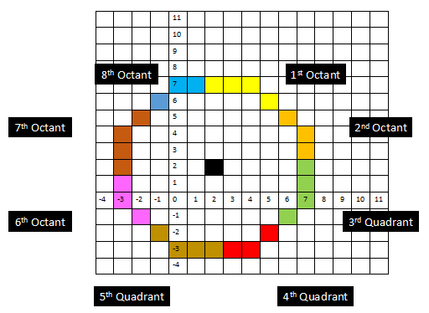
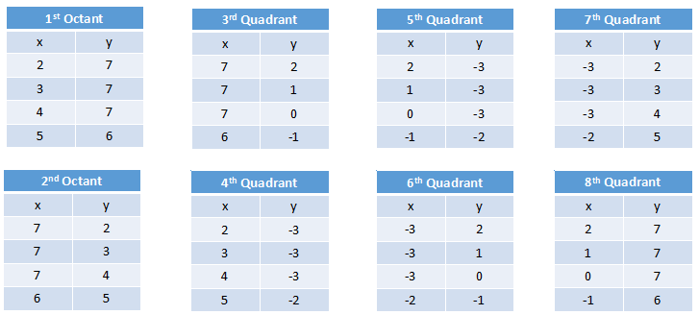
Task
4.2 Create a circle in the center point (x,y) with r = z. where x,y,z value depend on your nim (3 last digits). Draw the full octant tables and the circle as shown
If z is less than 5, add 4 to your z value

